Slide 1
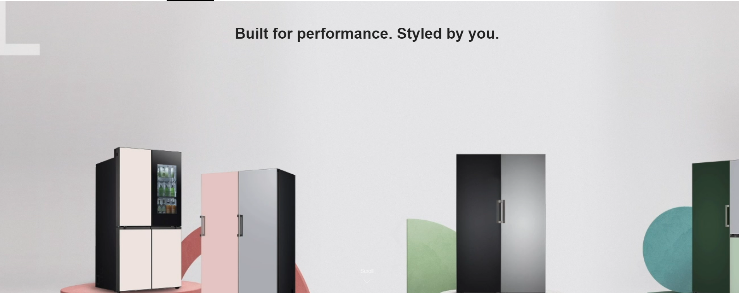
Interchangeable panels allow you to customise your LG Objet® Collection fridge and freezer with a choice of colours and finishes.
Explore LG Objet® Collection below and customise to suit your style via the Virtual Experience.*
Is it possible to add an explanation of the concept?
Interchangeable panels allow you to customise your LG Objet® Collection fridge and freezer with a choice of colours and finishes to complement your style.*
Explore LG Objet® Collection and customise to suit your style.
Add disclaimer under feature image.
*LG Objet® Collection comes in colour configuration indicated in product name if no custom panels are selected. Custom panels can be selected at checkout and will be fitted to your LG Objet® Collection product prior to dispatch as part of the initial purchase price. Delivery of customised order is dependent on stock availability of the colour panels at time of purchase. Estimated delivery for customised order with colour panels in stock is up to 4 weeks from purchase date. Please contact LG support team at obsanz@lge.com for any queries including orders, specific requirements and indicative delivery timeframes.
*LG Objet® Collection comes in colour configuration indicated in product name if no custom panels are selected. Custom panels can be selected at checkout and will be fitted to your LG Objet® Collection product prior to dispatch as part of the initial purchase price. Delivery of customised order is dependent on stock availability of the colour panels at time of purchase. Estimated delivery for customised order with colour panels in stock is up to 4 weeks from purchase date. Please contact LG support team at obsanz@lge.com for any queries including orders, specific requirements and indicative delivery timeframes.

Slide 2
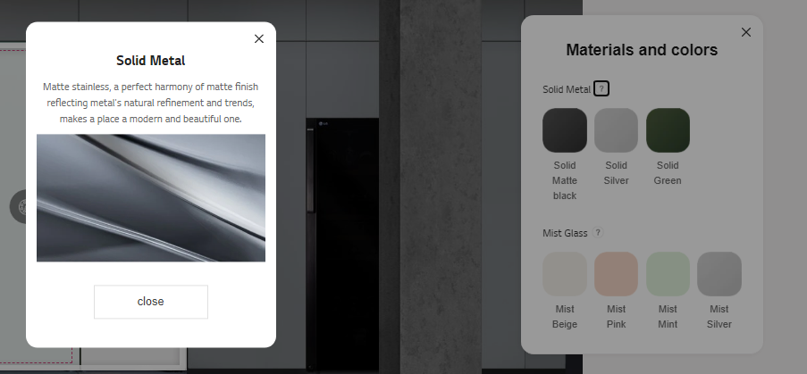
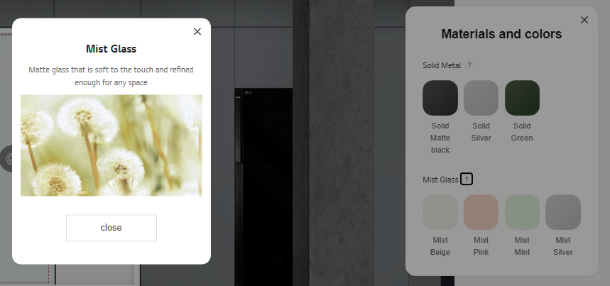
REPLACE ALL WITH BELOW;
Stainless Steel
Boldy modern, luxurious colours in matte stainless.
REPLACE ALL WITH BELOW;
Stainless Steel
Silver Stainless
Green Stainless
Matte Black Stainless
Mist Glass
Beige Mist
Silver Mist
Pink Mist
Mint Mist
REPLACE ALL WITH BELOW;
Mist Glass
Calming, forest inspired colours in mist glass.

Slide 3
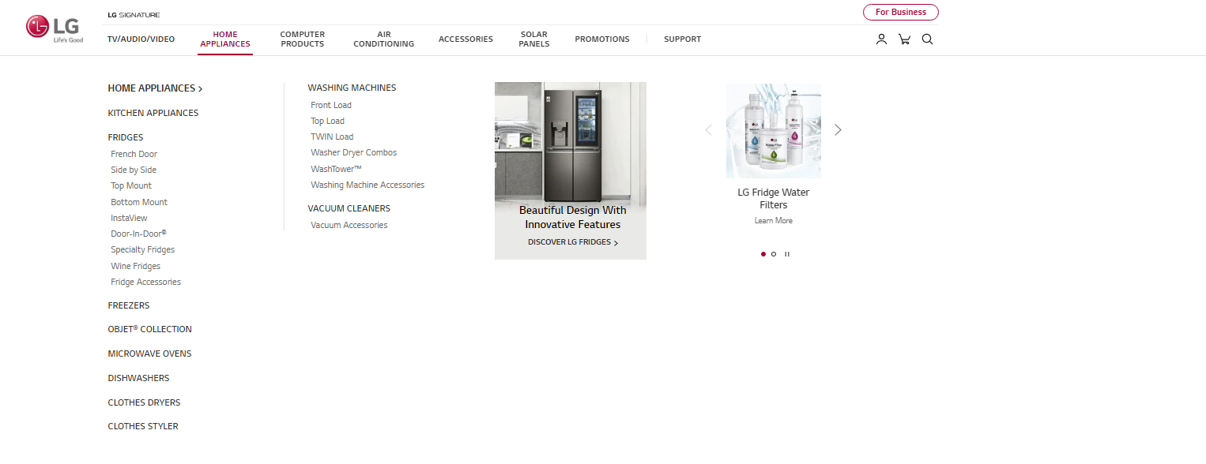
GNB Objet Nav
NEW OBJET GNB TILE TO COME >> microsite
Should this link direct to the microsite, or to filter page for Objet Product? I think we should we add sub filter for Objet Collection named ‘Fridges & Freezers’ and ‘Panels’ that navigates to filter pages, while the top level navigates to microsite?

Slide 4
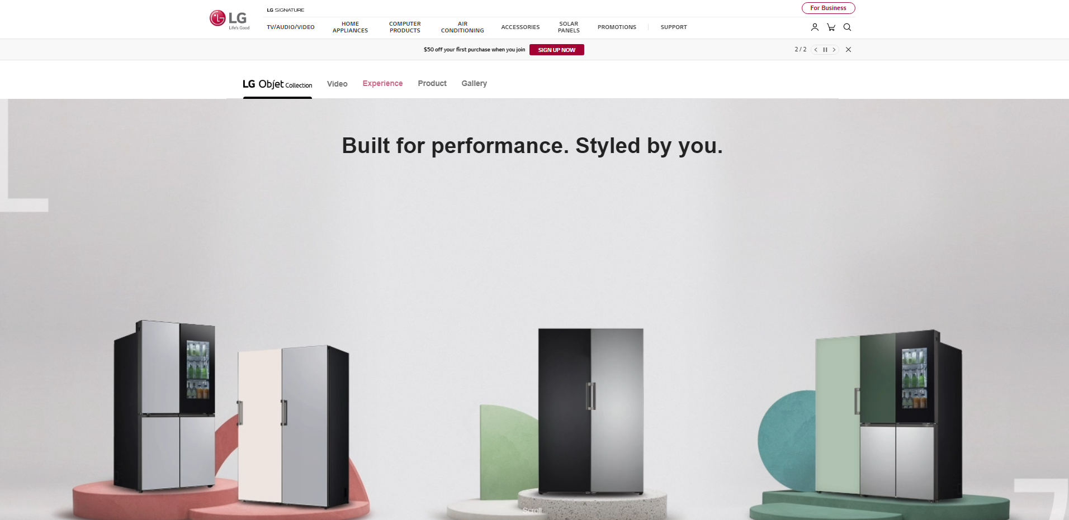
Objet FAQs
Can we add FAQs section?

